Slide 1
Boston Housing Analysis
Exploratory Data Analysis (EDA)
Prepared by: Saif Aleslam

Slide 2
In this project, I performed Exploratory Data Analysis (EDA) on the Boston Housing dataset.
The goal is to understand the factors that affect house prices.

Slide 3
Dataset Overview
Number of rows: 506 Number of columns: 14 No missing values
No duplicate data
All features are numerical
The dataset includes features like:
CRIM, RM, LSTAT, TAX, and MEDV (house price)

Slide 4
Data Cleaning
Checked for missing values → None found
Checked for duplicates → None found
Data types are correct
So, the dataset is clean and ready for analysis.

Slide 5
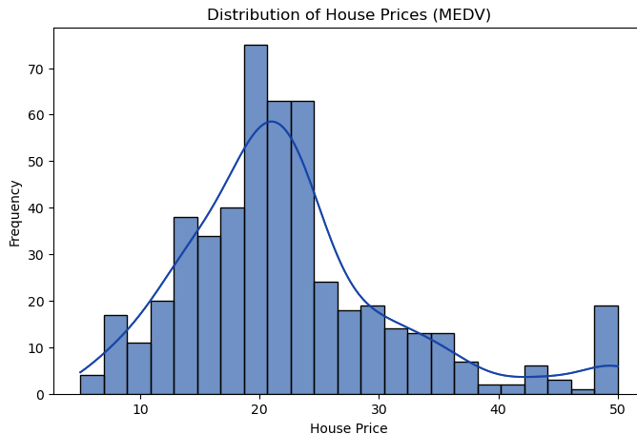


Average House Price
Average House Price ≈
22.53
Most houses are between 20 and 25
There are some higher-priced houses, which increase the average.

Slide 6
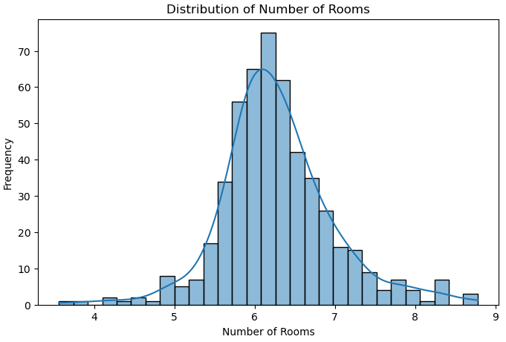



Rooms
Average number of rooms ≈ 6.28
Most houses have around 6 rooms.
The distribution is close to normal.

Slide 7
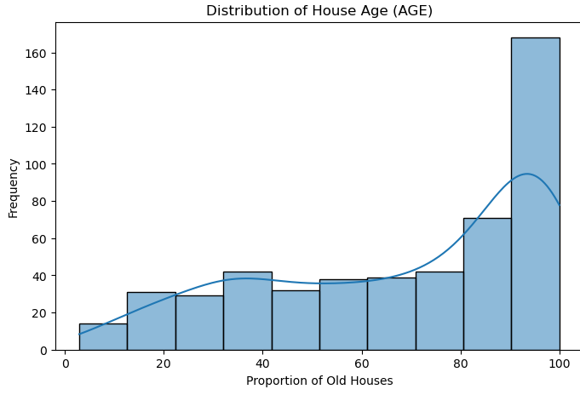

Average age of houses
Average AGE ≈ 68.57 Most houses are old (built before 1940).
New houses are less common in the dataset.

Slide 8
Average pupil-teacher
Average pupil-teacher ratio ≈ 18.46
Most values are between 18 and 20. There is not much variation.

Slide 9
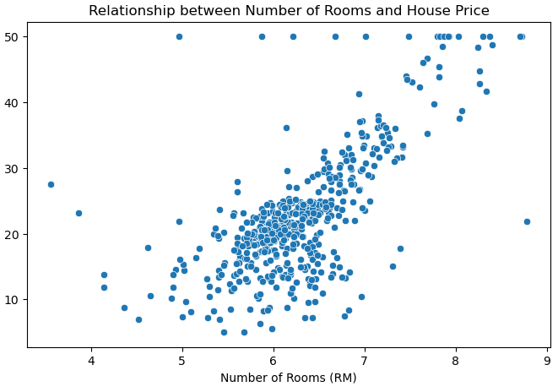
Rooms vs House Price
More rooms → Higher price
Correlation ≈ 0.69
As the number of rooms increases, house prices increase.
This shows that room count is an important factor.

Slide 10
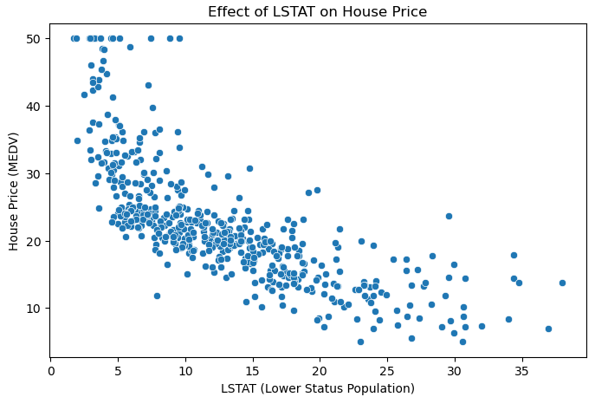


LSTAT vs House Price
Higher LSTAT → Lower price
Correlation ≈ -0.73
As LSTAT increases, house prices decrease.
This is the strongest relationship in the dataset.

Slide 11
Key Insights
RM increases house prices LSTAT decreases house prices
Strong relationships exist in the data. Bigger houses are usually in wealthier areas

Slide 12
Conclusion
House prices are affected by multiple factors.
The most important ones are:
Number of rooms (RM)
Lower-status population (LSTAT)
Understanding these relationships helps in predicting house prices.

